Slide 1

Oscillations, Waves and Optics
July, 2022, ASTU
ASTU
Cover Page - 1/32
July – 2022

Slide 2


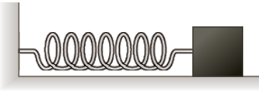
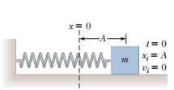

Simple Harmonic Motion
Periodic or oscillatory motion is motion of an object that regularly returns to a given position after a fixed time interval.
If something is oscillating (vibrating) this means that it is moving backwards and forwards, up and down, side to side, and in and out around some central position (equilibrium point).
Simple harmonic motion (SHM) is a special type of periodic motion or oscillation where;
motion is about an equilibrium position at which point no net force acts on the system,
the restoring force is directly proportional to the displacement 𝒙 from the equilibrium position
acts in the direction opposite to that of displacement.
m
ASTU
Simple Harmonic Motion - 2/32
July – 2022

Slide 3
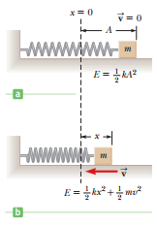


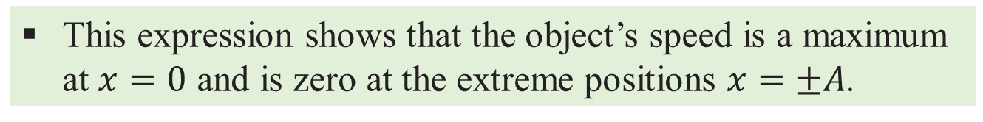
Simple Harmonic Motion
Velocity as a Function of Position
Conservation of energy provides a simple method of deriving an expression for the velocity of an object undergoing periodic motion as a function of position.
This expression shows that the object’s speed is a maximum at $x=0$ and is zero at the extreme positions $x=±A$.
ASTU
Simple Harmonic Motion - 3/32
July – 2022

Slide 4
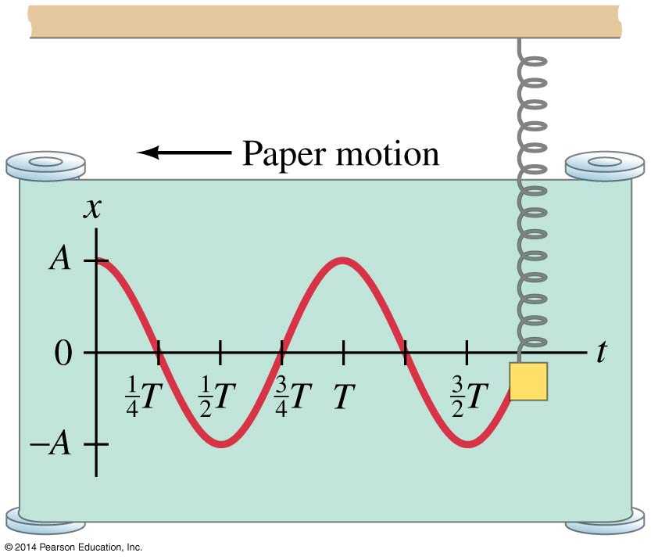
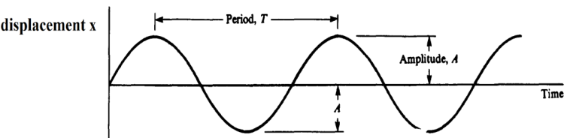








Simple Harmonic Motion
Period and Frequency
The frequency of the periodic motion of a mass on a spring is
The angular frequency $(ω)$ is
ASTU
Simple Harmonic Motion - 4/32
July – 2022

Slide 5






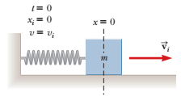




Simple Harmonic Motion
First condition
The solution is
Second condition
ASTU
Simple Harmonic Motion - 5/32
July – 2022

Slide 6



Simple Harmonic Motion
Example 1
A 0.2kg block connected to a light spring for which the force constant is 5 N/m is free to oscillate on a frictionless, horizontal surface. The block is displaced 5 cm from equilibrium and released from rest. A) Find the period of its motion. B) Determine the maximum speed and acceleration of the block. C) Express the position, velocity, and acceleration as functions of time.
ASTU
Simple Harmonic Motion - 6/32
July – 2022

Slide 7







Simple Harmonic Motion
Example 2
What if the block were released from the same initial position, $x_{i}=5 cm$, but with an initial velocity of $v_{i}=−0.100 m/s$?
ASTU
Simple Harmonic Motion - 7/32
July – 2022

Slide 8

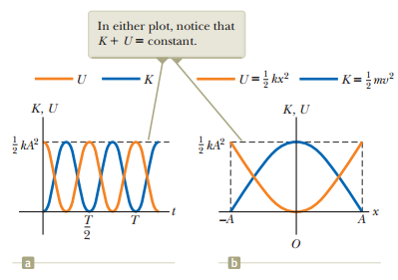

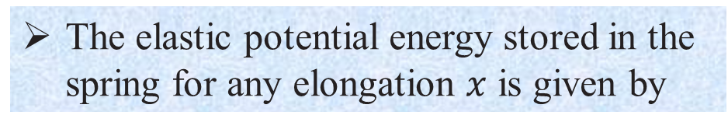
Simple Harmonic Motion
Energy of the Simple Harmonic Oscillator
The kinetic energy of the block is
The elastic potential energy stored in the spring for any elongation $x$ is given by
Total mechanical energy
ASTU
Simple Harmonic Motion - 8/32
July – 2022

Slide 9

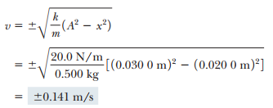
Simple Harmonic Motion
Example 3
A 0.500kg cart connected to a light spring for which the force constant is 20.0 N/m oscillates on a frictionless, horizontal air track. A) Calculate the maximum speed of the cart if the amplitude of the motion is 3.00 cm. B) What is the velocity of the cart when the position is 2.00 cm? C) Compute the kinetic and potential energies of the system when the position of the cart is 2.00 cm.
ASTU
Simple Harmonic Motion - 9/32
July – 2022

Slide 10
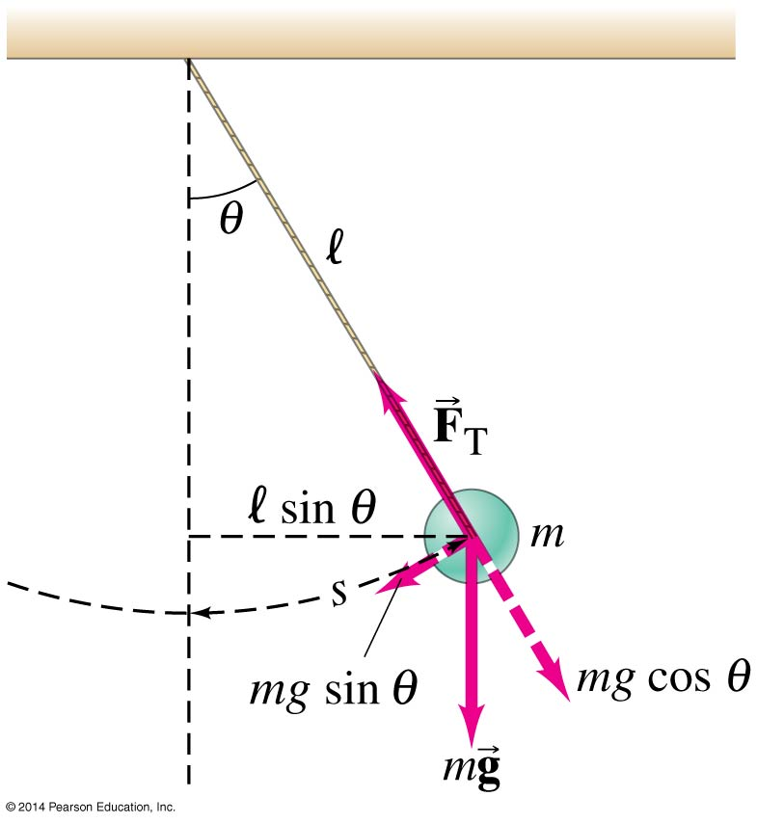



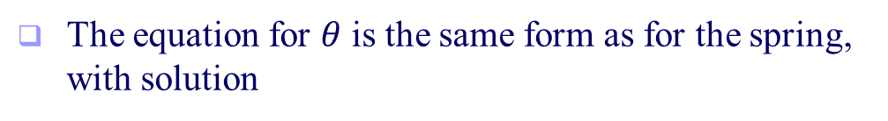
Simple Harmonic Motion
The Simple Pendulum
The forces acting on the bob are the tension and the weight.
T is the force exerted by the string
mg is the gravitational force
The tangential component of the gravitational force is the restoring force.
Recall that the tangential acceleration is
This gives another differential equation
The equation for $θ$ is the same form as for the spring, with solution
ASTU
Simple Harmonic Motion - 10/32
August - 2021
July – 2022

Slide 11
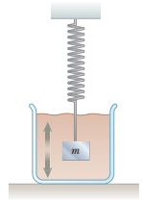





Simple Harmonic Motion
Damped Oscillations
In many real systems, nonconservative forces such as friction or air resistance also act and retard the motion of the system. Consequently, the mechanical energy of the system diminishes in time, and the motion is said to be damped.
where $ω_{0}=\sqrt{k/m}$ represents the angular frequency in the absence of a retarding force (the undamped oscillator) and is called the natural frequency of the system.
ASTU
Simple Harmonic Motion - 11/32
July – 2022

Slide 12
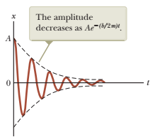
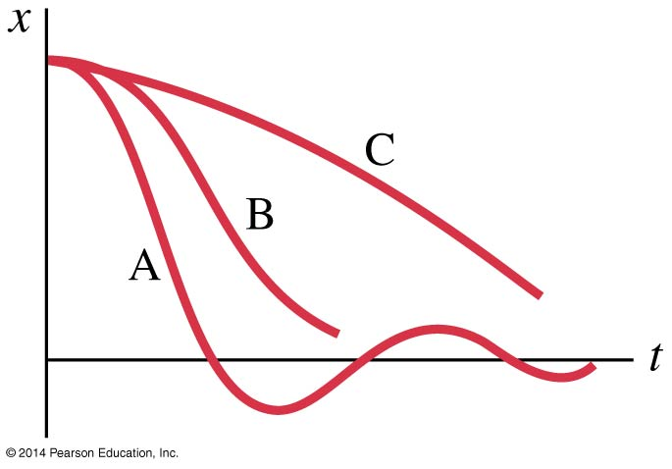
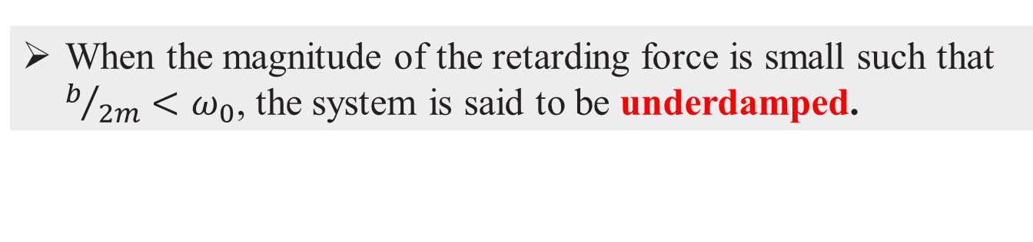
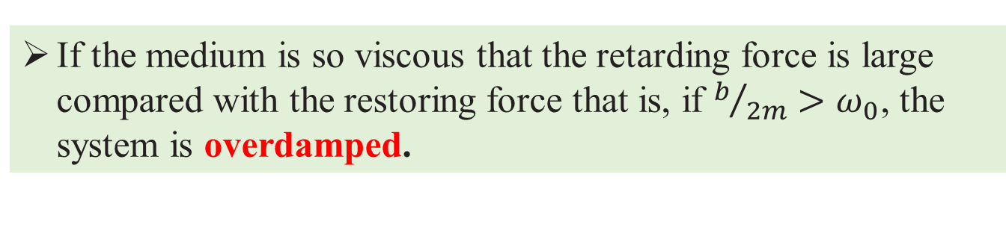
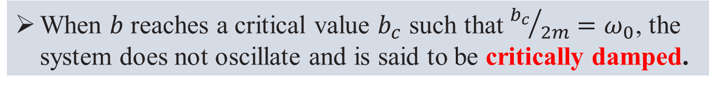
Simple Harmonic Motion
When the magnitude of the retarding force is small such that $b/{2m}<ω_{0}$, the system is said to be underdamped.
A: underdamping: there are a few small oscillations before the oscillator comes to rest.
When $b$ reaches a critical value $b_{c}$ such that ${b_{c}}/{2m}=ω_{0}$, the system does not oscillate and is said to be critically damped.
B: critical damping: this is the fastest way to get to equilibrium.
If the medium is so viscous that the retarding force is large compared with the restoring force that is, if $b/{2m}>ω_{0}$, the system is overdamped.
C: overdamping: the system is slowed so much that it takes a long time to get to equilibrium.
ASTU
Simple Harmonic Motion - 12/32
July – 2022

Slide 13

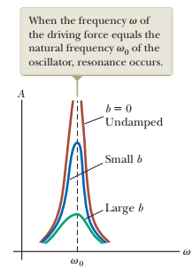


Simple Harmonic Motion
Forced Oscillations
Forced vibrations occur when there is a periodic driving force. This force may or may not have the same period as the natural frequency of the system.
If the frequency is the same as the natural frequency, the amplitude becomes quite large. This is called resonance.
ASTU
Simple Harmonic Motion - 13/32
July – 2022

Slide 14
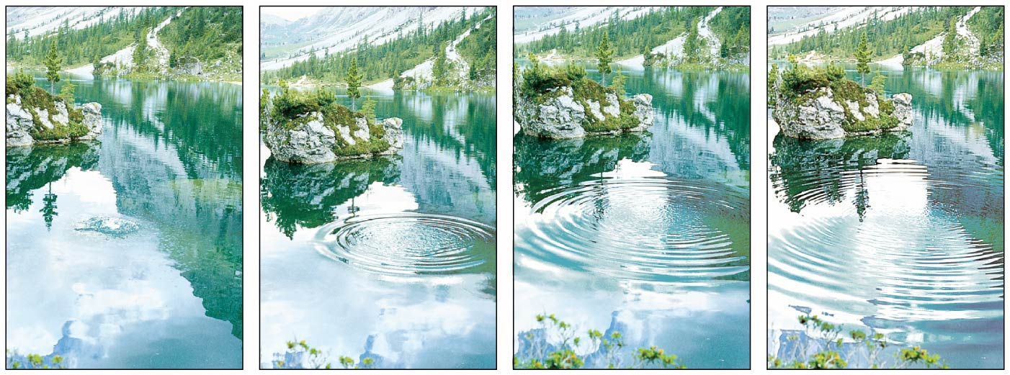
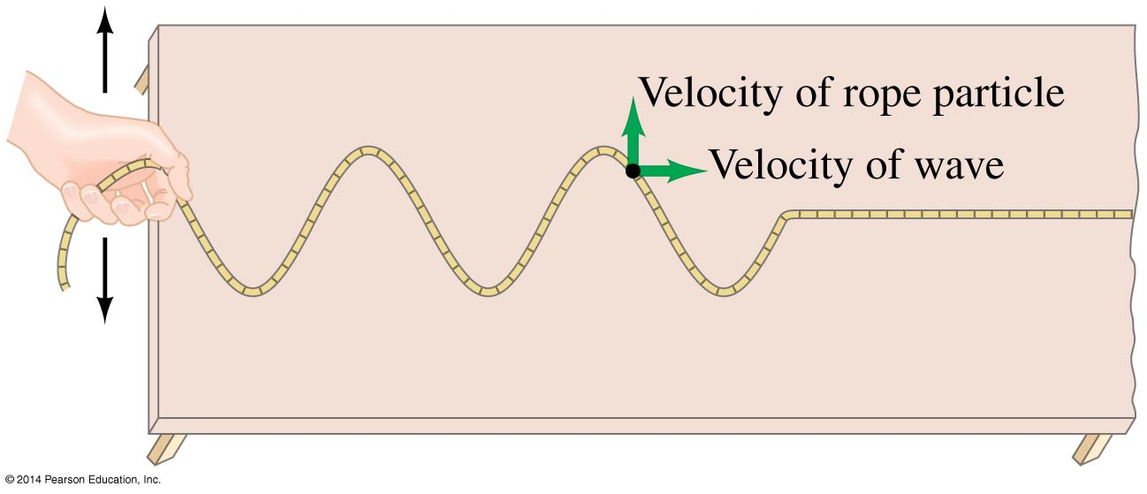

Wave Motion
A wave is a disturbance that carries energy from place to place.
A wave does NOT carry matter with it! It just moves the matter as it goes through it.
ASTU
Wave Motion - 14/32
July – 2022

Slide 15
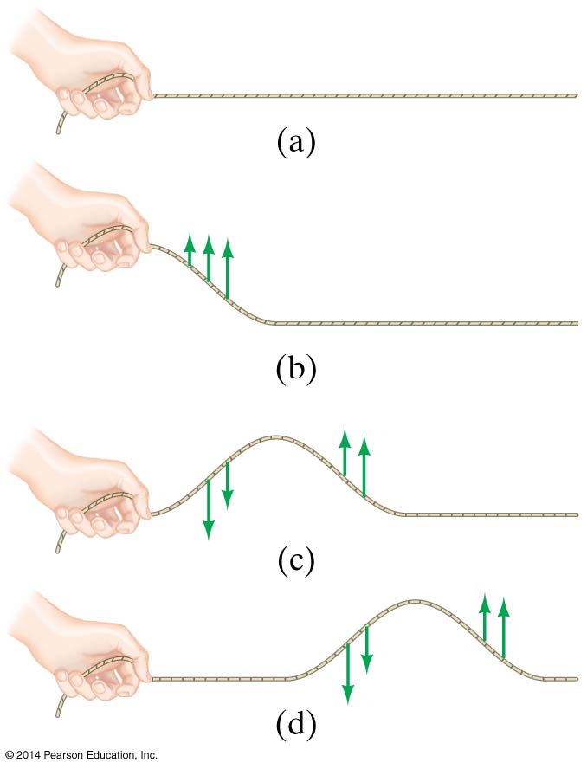
Wave Motion
Some waves do not need matter (called a “medium”) to be able to move (for example, through space). These are called electromagnetic waves (or EM waves).
Some waves MUST have a medium in order to move. These are called mechanical waves.
ASTU
Wave Motion - 15/32
July – 2022

Slide 16
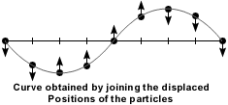
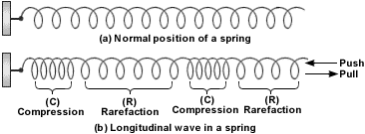
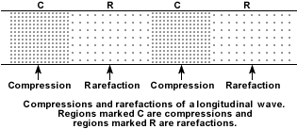
Wave Motion
Type of wave
Transverse waves: Waves in which the medium moves at right angles to the direction of the wave.
2. Compressional (or longitudinal) waves: Waves in which the medium moves back and forth in the same direction as the wave.
ASTU
Wave Motion - 16/32
July – 2022

Slide 17
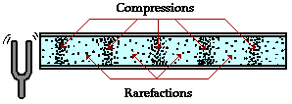
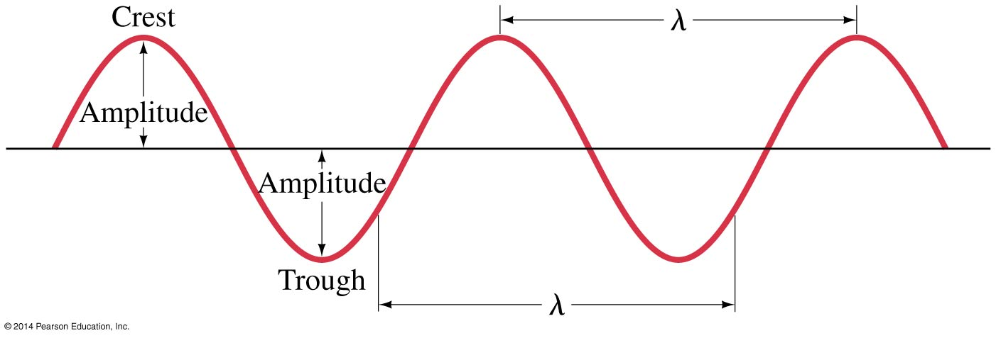
Wave Motion
Crest: the highest point of the wave.
Trough: the lowest point of the wave.
Compression: where the particles are close together
Rarefaction: where the particles are spread apart
Frequency (f): how many waves go past a point in one second; unit of measurement is hertz (Hz).
Wavelength (λ): The distance between one point on a wave and the exact same place on the next wave.
Amplitude (A): how far the medium moves from rest position (where it is when not moving).
Period (T): is the time it takes for one cycle to complete.
ASTU
Wave Motion - 17/32
July – 2022

Slide 18
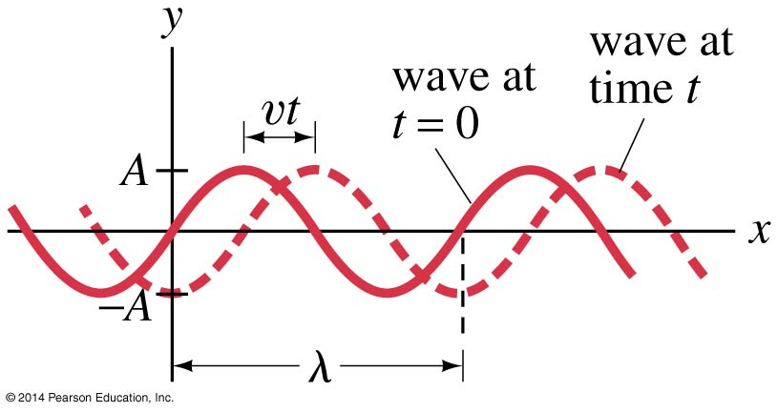







Wave Motion
Traveling wave
The function describing the positions of the elements of the medium through which the sinusoidal wave is traveling can be written
ASTU
Wave Motion - 18/32
July – 2022

Slide 19
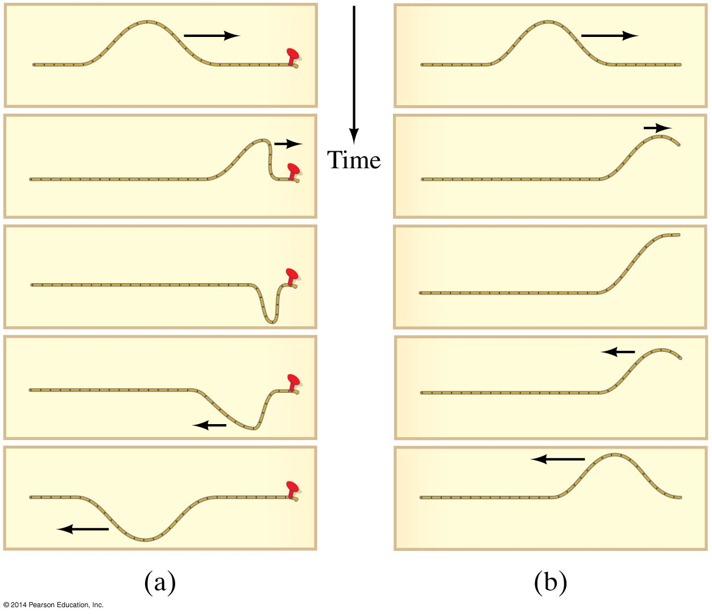
Wave Motion
Reflection and Transmission of Waves
A wave reaching the end of its medium, but where the medium is still free to move, will be reflected (b), and its reflection will be upright.
A wave hitting an obstacle will be reflected (a), and its reflection will be inverted.
ASTU
Wave Motion - 19/32
July – 2022

Slide 20
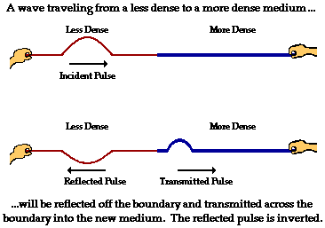
Wave Motion
In this situation part of the wave is reflected, and part of the wave is transmitted.
Part of the wave energy is transferred to the more dense medium, and part is reflected.
The transmitted pulse is upright, while the reflected pulse is inverted.
The speed and wavelength of the reflected wave remain the same, but the amplitude decreases.
The speed, wavelength, and amplitude of the transmitted pulse are all smaller than in the incident pulse.
ASTU
Wave Motion - 20/32
July – 2022

Slide 21
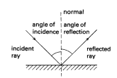
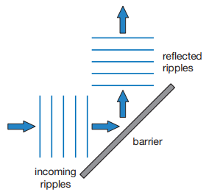
Wave Motion
Reflection;
Bounce off of wave.
Occurs when a waves reaches an obstacle/barrier.
Traveling in the opposite direction.
Its frequency does not change.
Obey first law of reflection of light.
The angle of incident = the angle of reflection
ASTU
Wave Motion - 21/32
July – 2022

Slide 22
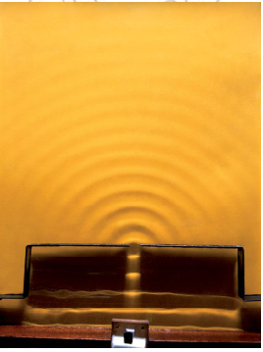
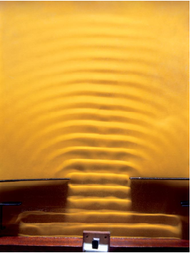
Wave Motion
Diffraction;
A spreading of wave after passing the edge of an obstacle or gap/slit.
Narrow gap has more effect.
Wide gap has less effect.
Large obstacle, small wavelength = low diffraction
Small obstacle, large wavelength = large diffraction
ASTU
Wave Motion - 22/32
July – 2022

Slide 23
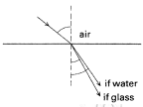
Wave Motion
Refraction;
breaking of wave.
Is a measure of the extent to which a medium reflects light.
Change speed and direction as they move from one material to another.
The wavelength may decrease/increase.
It use in lenses, camera, telescope.
ASTU
Wave Motion - 23/32
July – 2022

Slide 24
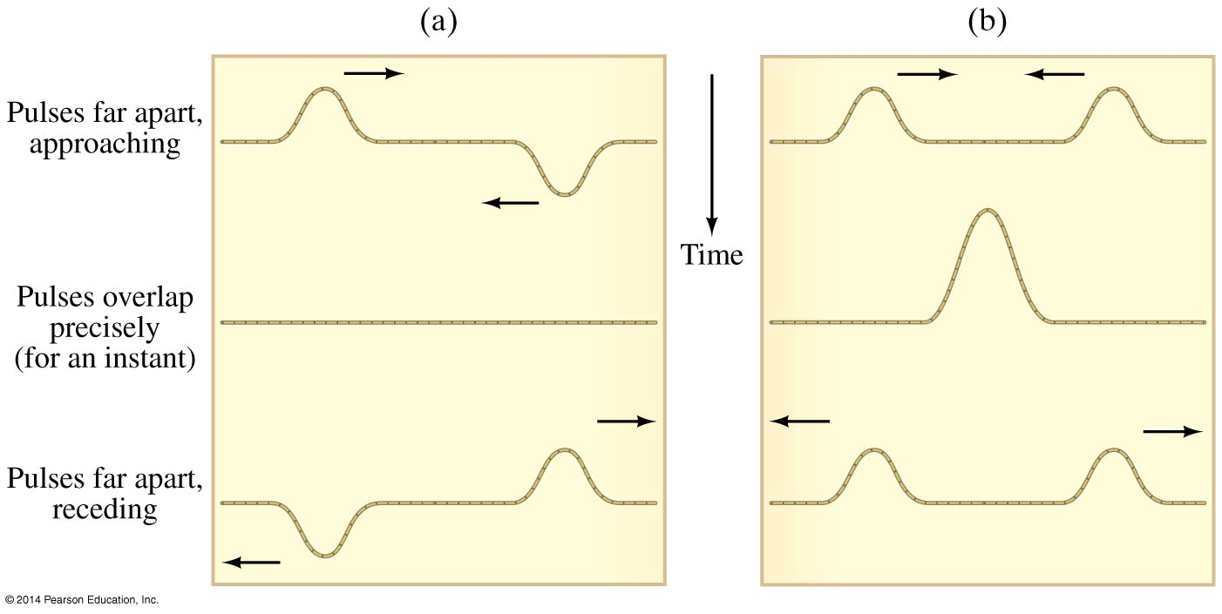
Wave Motion
The superposition principle says that when two waves pass through the same point, the displacement is the arithmetic sum of the individual displacements.
In the figure below, (a) exhibits destructive interference and (b) exhibits constructive interference.
ASTU
Wave Motion - 24/32
July – 2022

Slide 25
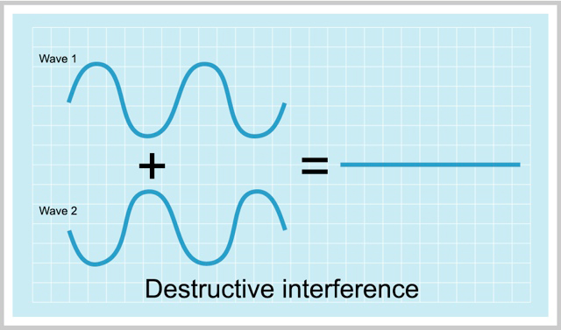
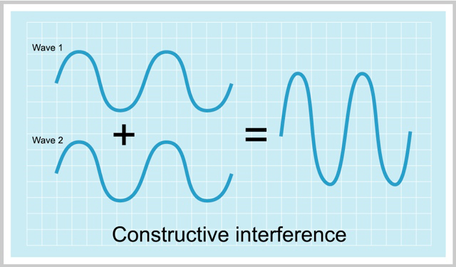
Wave Motion
Interference;
Add up or cancel out.
There are two types: constructive and destructive.
Constructive;
Destructive;
If two waves are in phase with each other they combine to make a bigger wave.
Constructive interference occurs when the crests of one wave are over the crests of another wave
If two waves are out of phase with each other they cancel each other, so that there is no wave.
ASTU
Wave Motion - 25/32
July – 2022

Slide 26
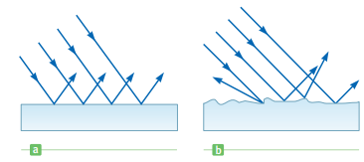
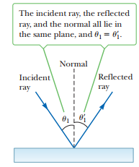

Light and Optics
light travels in a straight-line path in a homogeneous medium, until it encounters a boundary between two different materials.
The reflection of light from such a smooth surface is called specular reflection.
The reflection from any rough surface is known as diffuse reflection.
The angle of reflection equals the angle of incidence:
ASTU
Light and Optics - 26/32
July – 2022

Slide 27
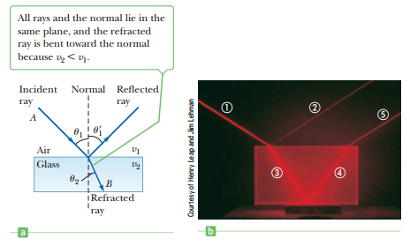
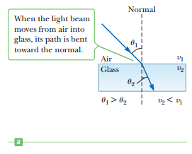
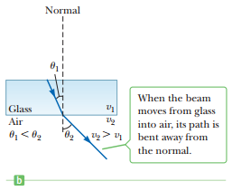

Light and Optics
ASTU
Light and Optics - 27/32
July – 2022

Slide 28
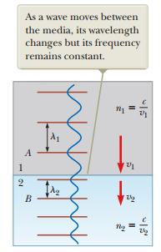



Light and Optics
The Law of Refraction
The index of refraction, $n$, of a medium is defined as:
As light travels from one medium to another, its frequency doesn’t change.
Snell’s law of refraction.
ASTU
Light and Optics - 28/32
July – 2022

Slide 29
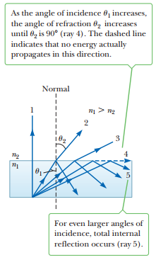
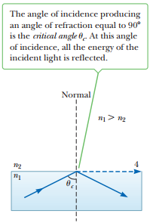

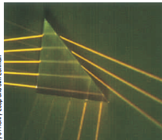
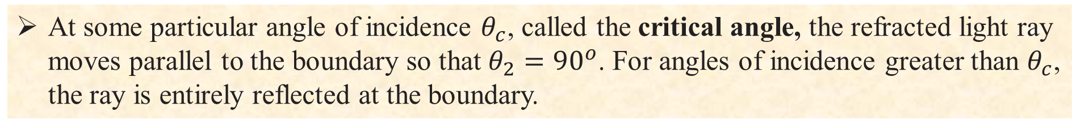
Light and Optics
At some particular angle of incidence $θ_{c}$, called the critical angle, the refracted light ray moves parallel to the boundary so that $θ_{2}={90}^{o}$. For angles of incidence greater than $θ_{c}$, the ray is entirely reflected at the boundary.
ASTU
Light and Optics - 29/32
July – 2022

Slide 30

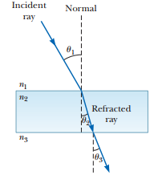


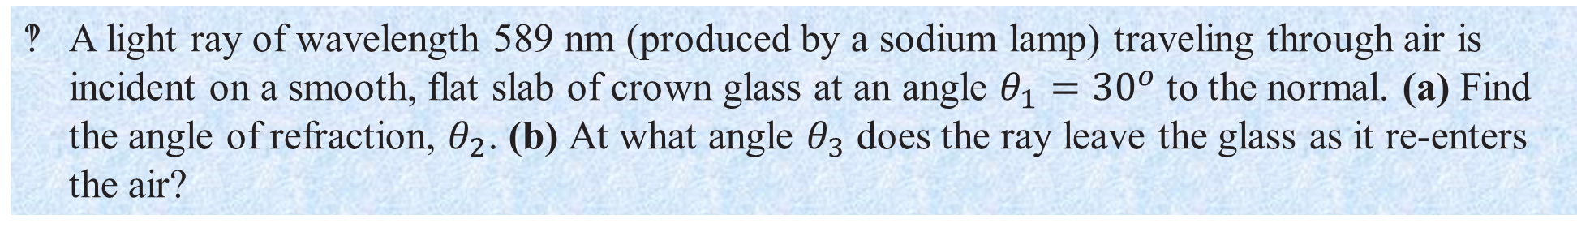
Light and Optics
Example 4
A light ray of wavelength 589 nm (produced by a sodium lamp) traveling through air is incident on a smooth, flat slab of crown glass at an angle $θ_{1}={30}^{o}$ to the normal. (a) Find the angle of refraction, $θ_{2}$. (b) At what angle $θ_{3}$ does the ray leave the glass as it re-enters the air?
ASTU
Light and Optics - 30/32
July – 2022

Slide 31



Image Formation
Images are formed at the point where rays of light actually intersect or where they appear to originate.
The image formed by an object placed in front of a flat mirror is as far behind the mirror as the object is in front of the mirror.
The lateral magnification M is defined as:
ASTU
Image Formation - 31/32
July – 2022

Slide 32
End
The End
ASTU
End - 32/32
July – 2022

